Slide 1
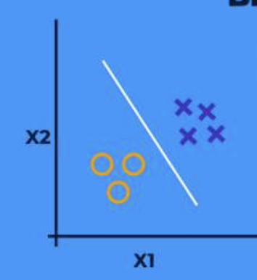

EMIT Mission
Task 2: Developing the Program
01
Selected Images from AVIRIS Mission
05
Developed Code to Separate Annotated Pixels
02
06
Developed Code to Calculate TOA Reflectance and Prep for ML
Annotated a Few Images
03
Conducted Research to Understand Machine Learning, Image Processing, and 3-D Arrays
07
Developed Code to Split data into Train and Test
04
08
Developed Code to Process Annotation and Spectral Cube Images
Trained & Tested Model; Determined Accuracy
Notes:
Explain point of knowing aerosol optical depth accuracy

Slide 2
EMIT Mission
Task 2: Developing the Program
01
05
09
Selected Images from AVIRIS Mission
Developed Code to Separate Annotated Pixels
Debugged & Tested - Fixed Multiple File Errors
02
06
Developed Code to Calculate TOA Reflectance and Prep for ML
10
Modified Code to Use Normalized Radiance Instead
Annotated a Few Images
03
Conducted Research to Understand Machine Learning, Image Processing, and 3-D Arrays
07
11
Developed Code for Classification Map
Developed Code to Split data into Train and Test
04
08
12
Selected Images from EMIT Mission
Developed Code to Process Annotation and Spectral Cube Images
Trained & Tested Model; Determined Accuracy
Notes:
Explain point of knowing aerosol optical depth accuracy

Slide 3
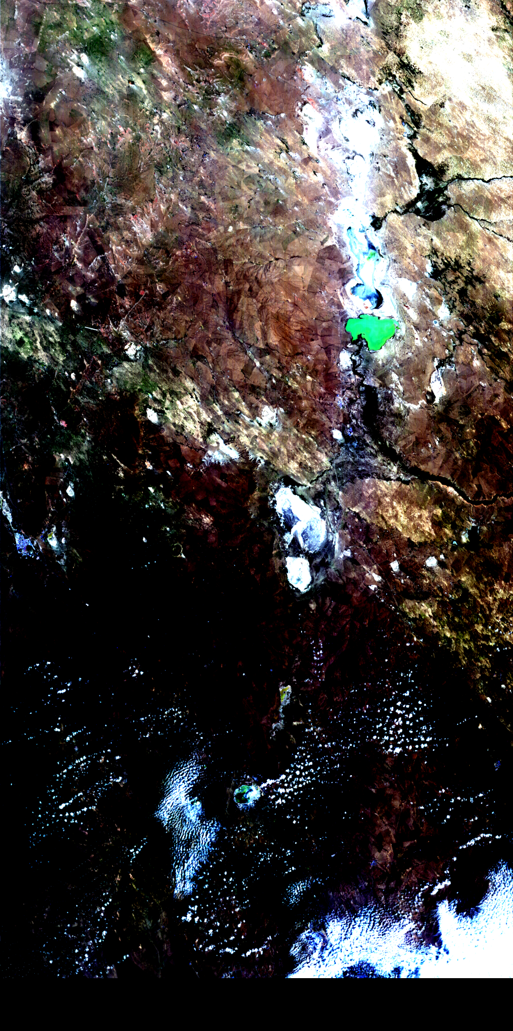

EMIT Mission
Task 2: Developing the Program
Notes:
Explain point of knowing aerosol optical depth accuracy

Slide 4
EMIT Mission
Task 2: Developing the Program Part 2
13
17
Developed Code to Apply Model to Non-Annotated Images
Annotated EMIT Images
14
Modified Code to Train/Test on Multiple Images
18
Debugged & Tested
15
19
Re-Annotated Ten Images due to Location Errors
Attempted Methods to Improve Performance
16
Tested Different Models to Improve Accuracy
Notes:
Explain point of knowing aerosol optical depth accuracy

Slide 5
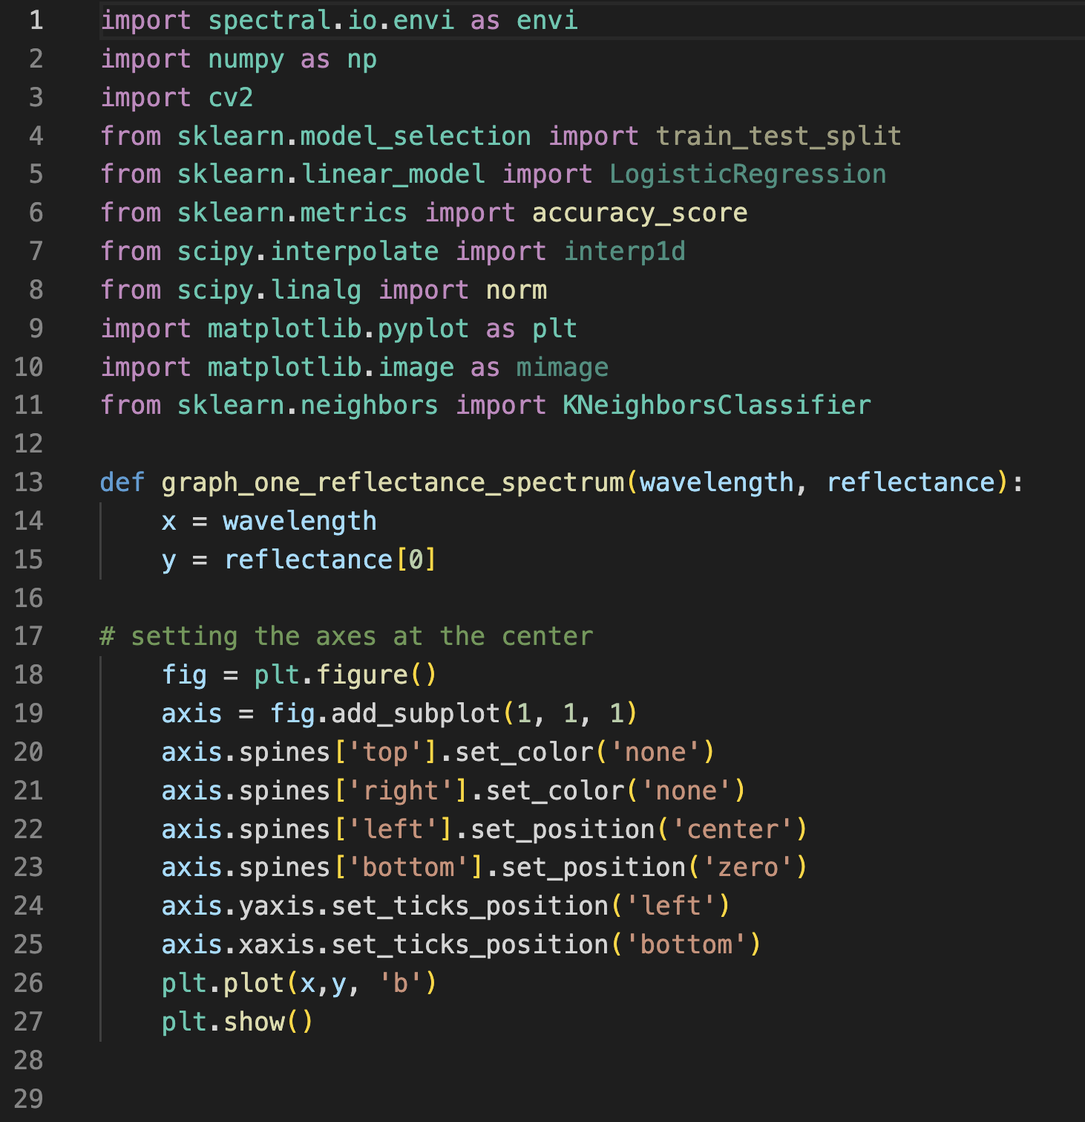
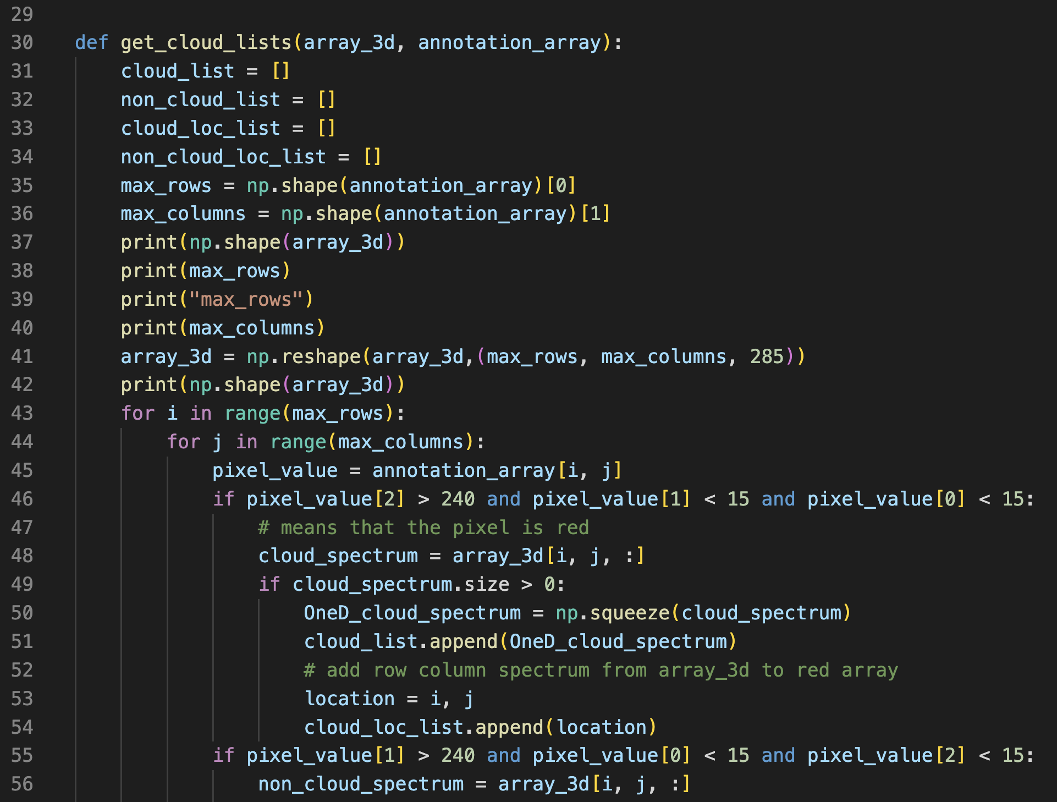
EMIT Mission
Task 2: Code
Notes:
Explain point of knowing aerosol optical depth accuracy

Slide 6
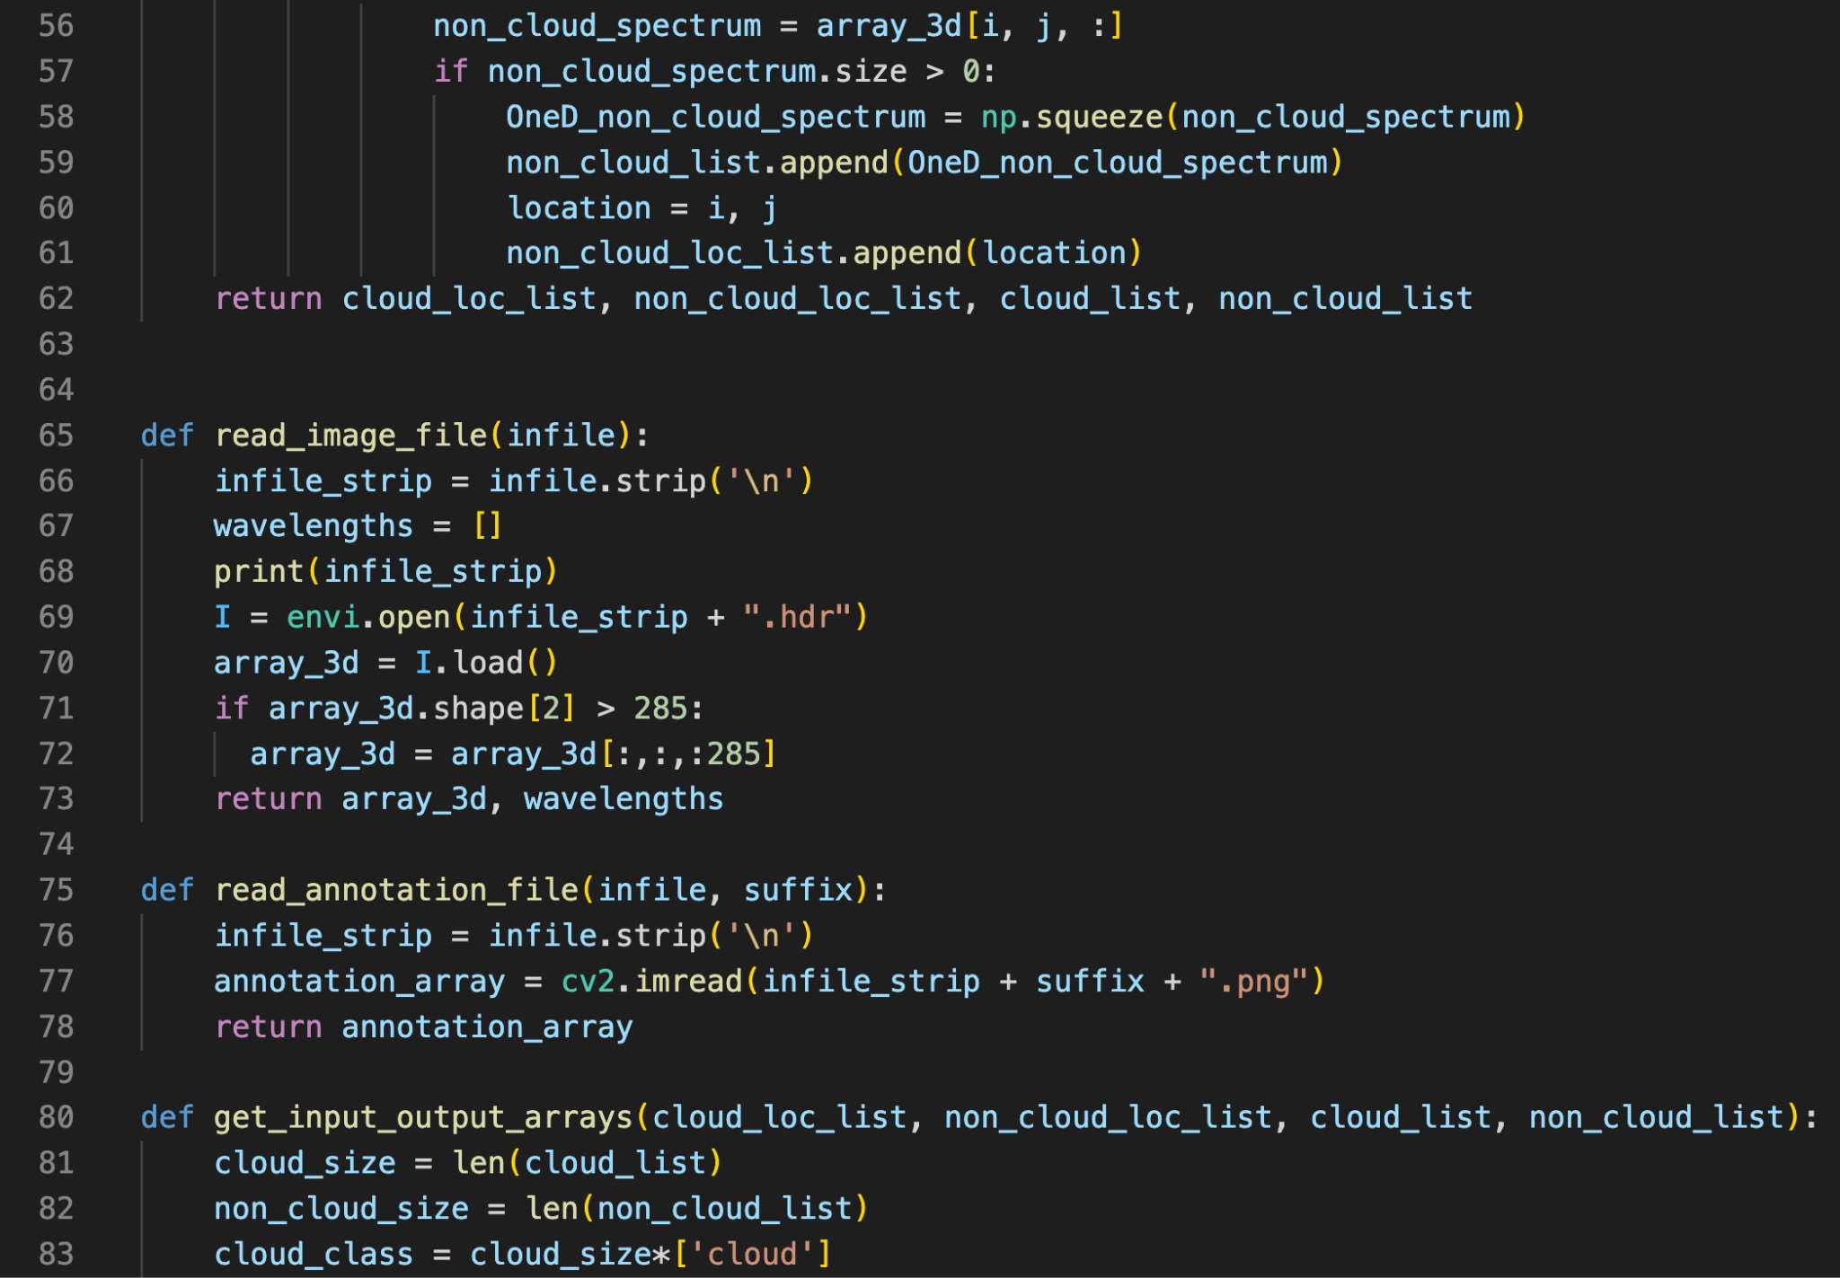
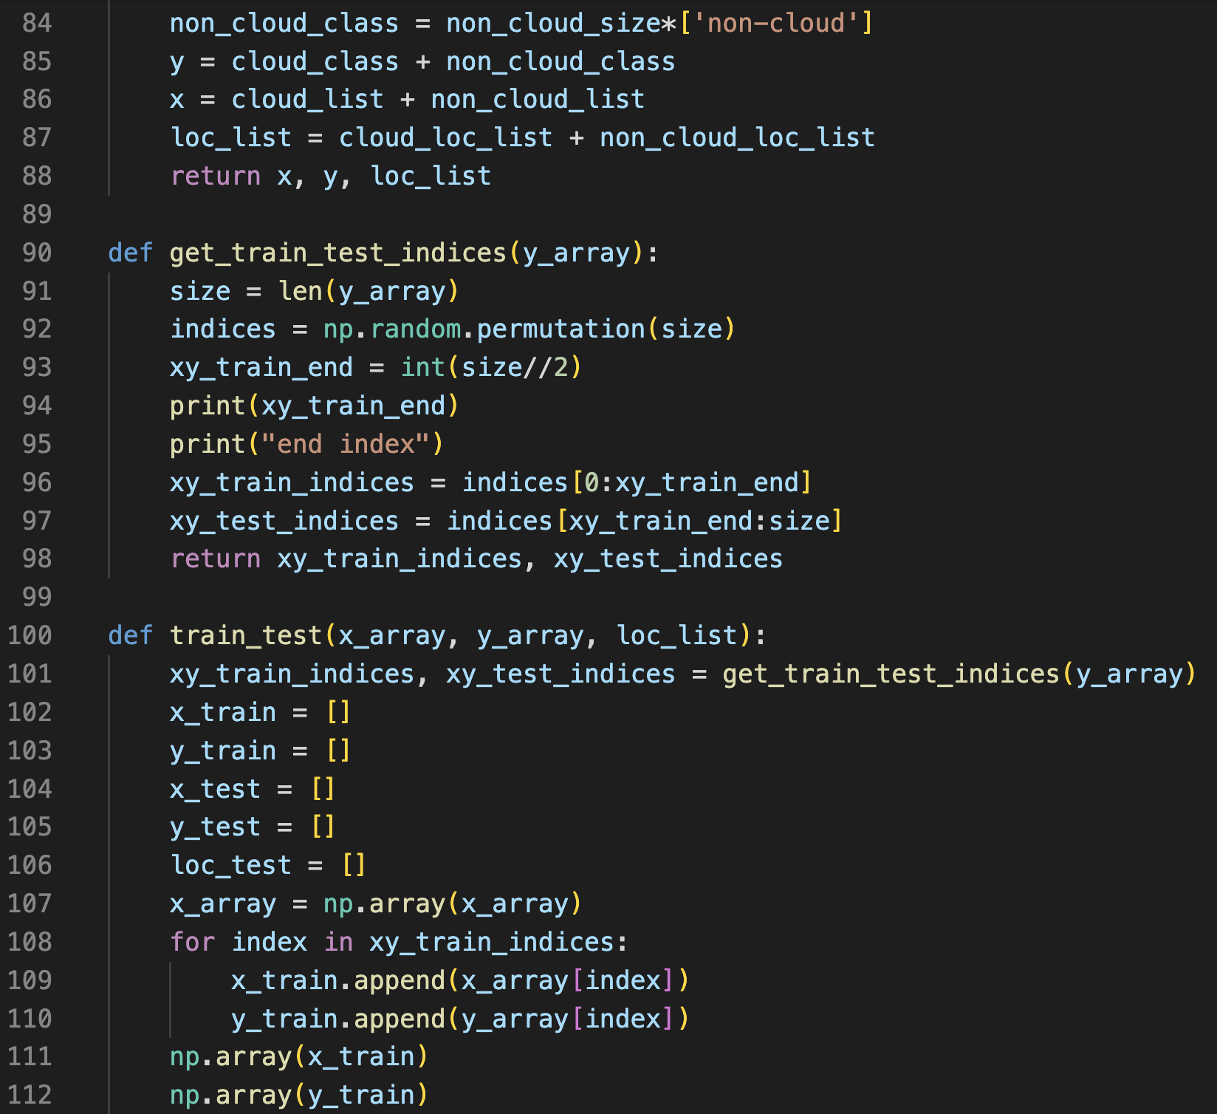
EMIT Mission
Task 2: Code
Notes:
Explain point of knowing aerosol optical depth accuracy

Slide 7
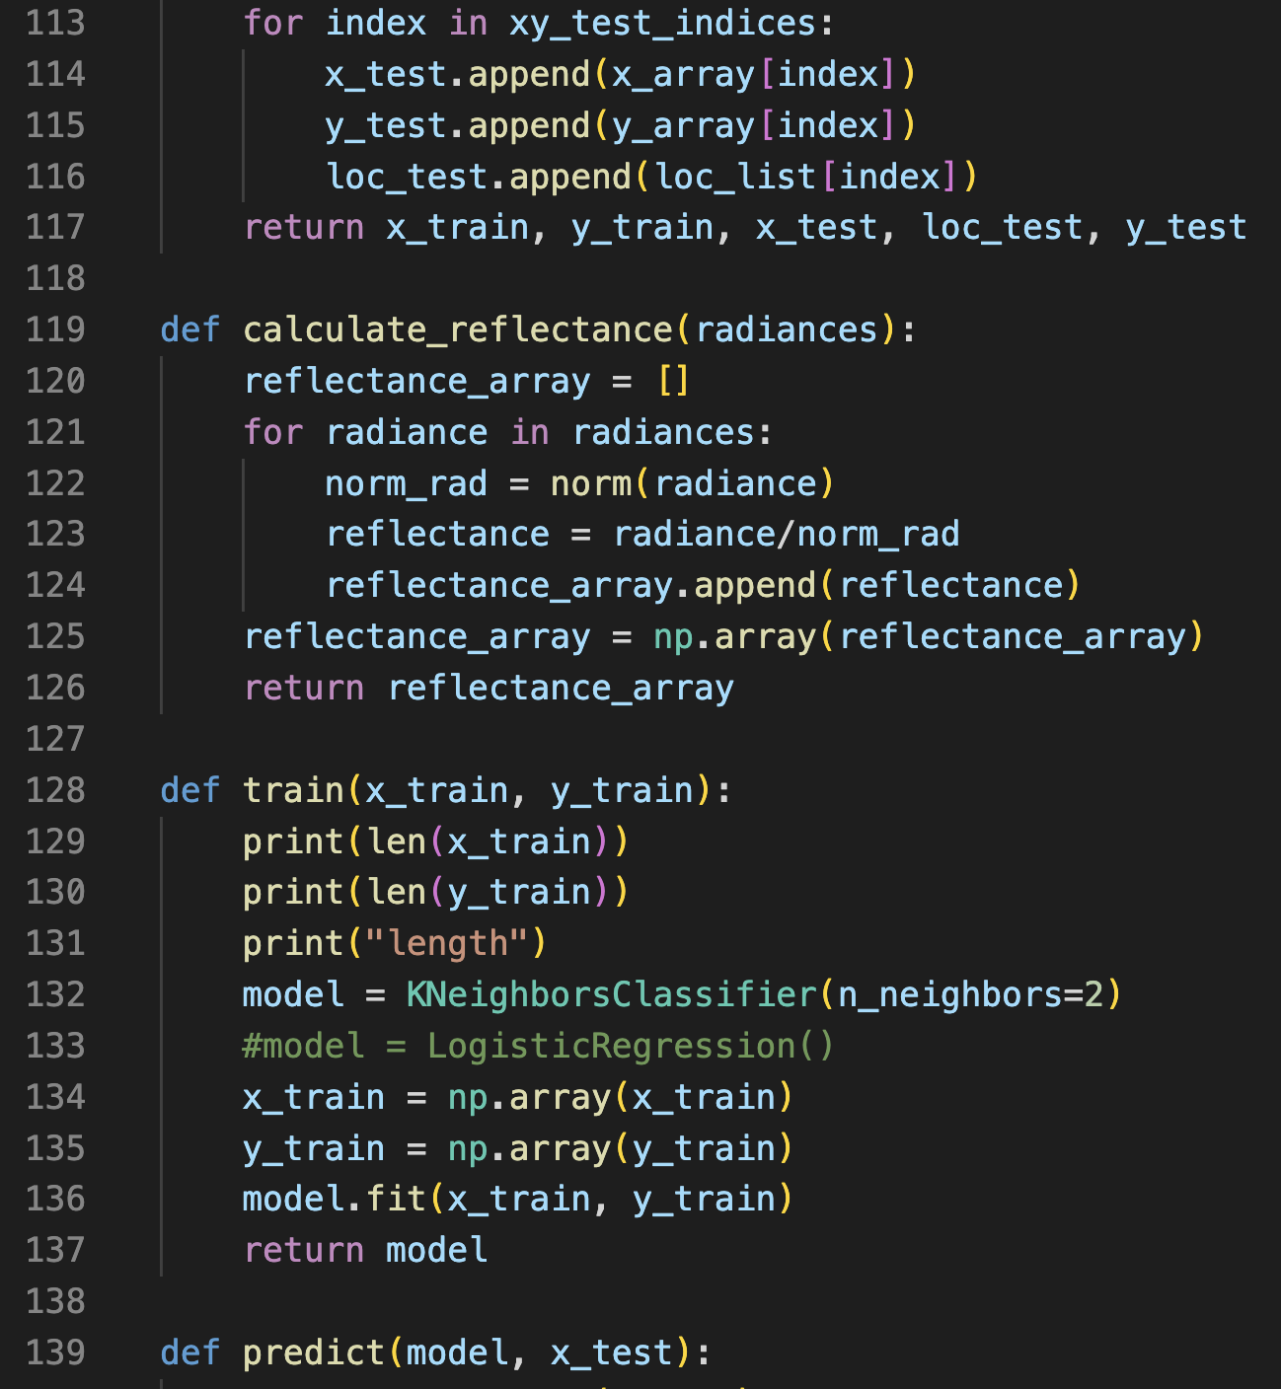
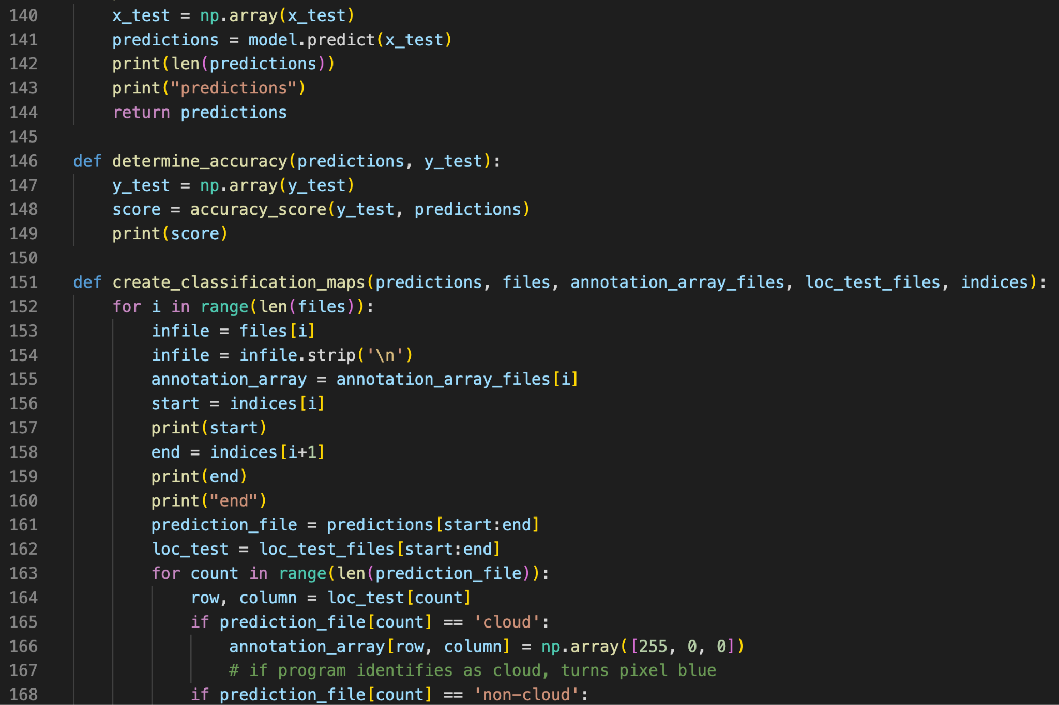
EMIT Mission
Task 2: Code
Notes:
Explain point of knowing aerosol optical depth accuracy

Slide 8
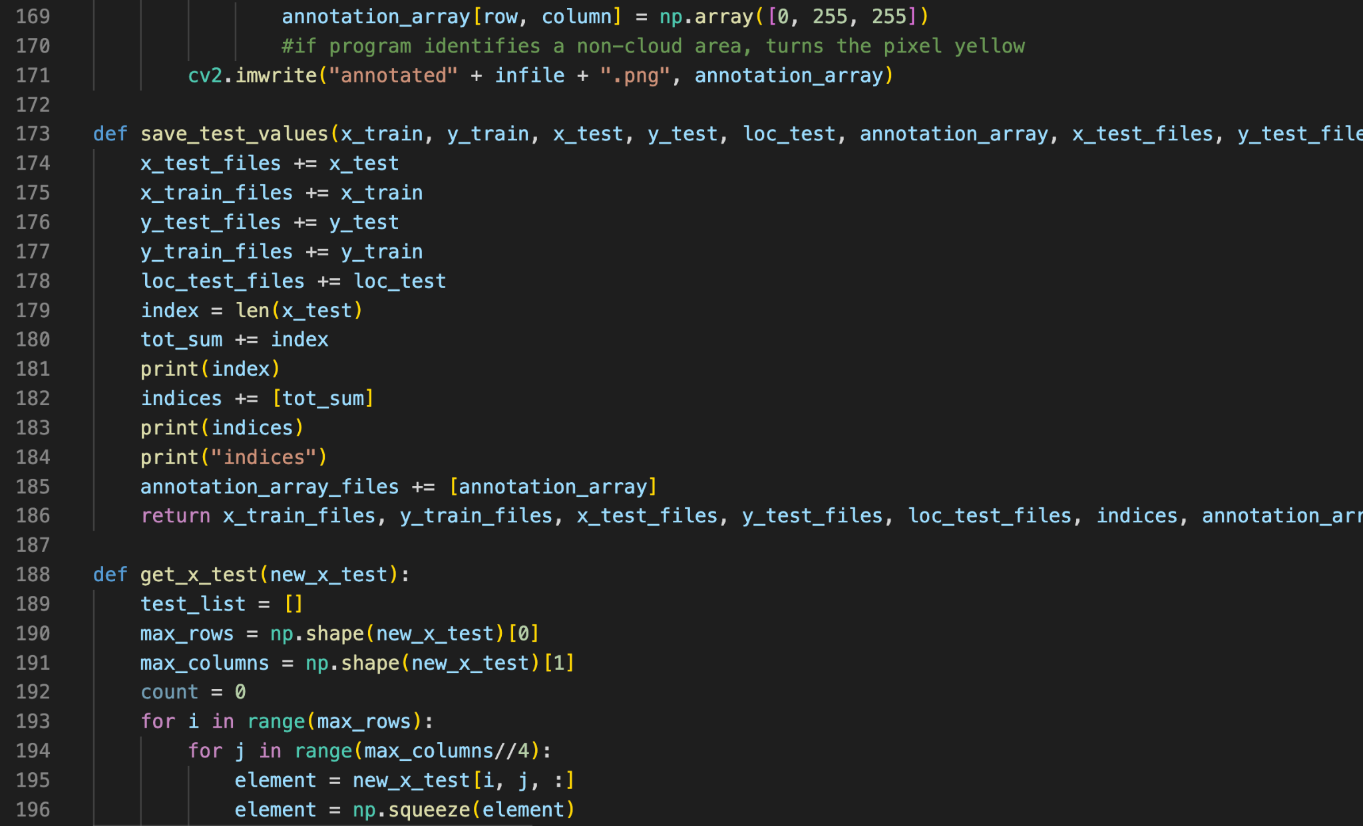
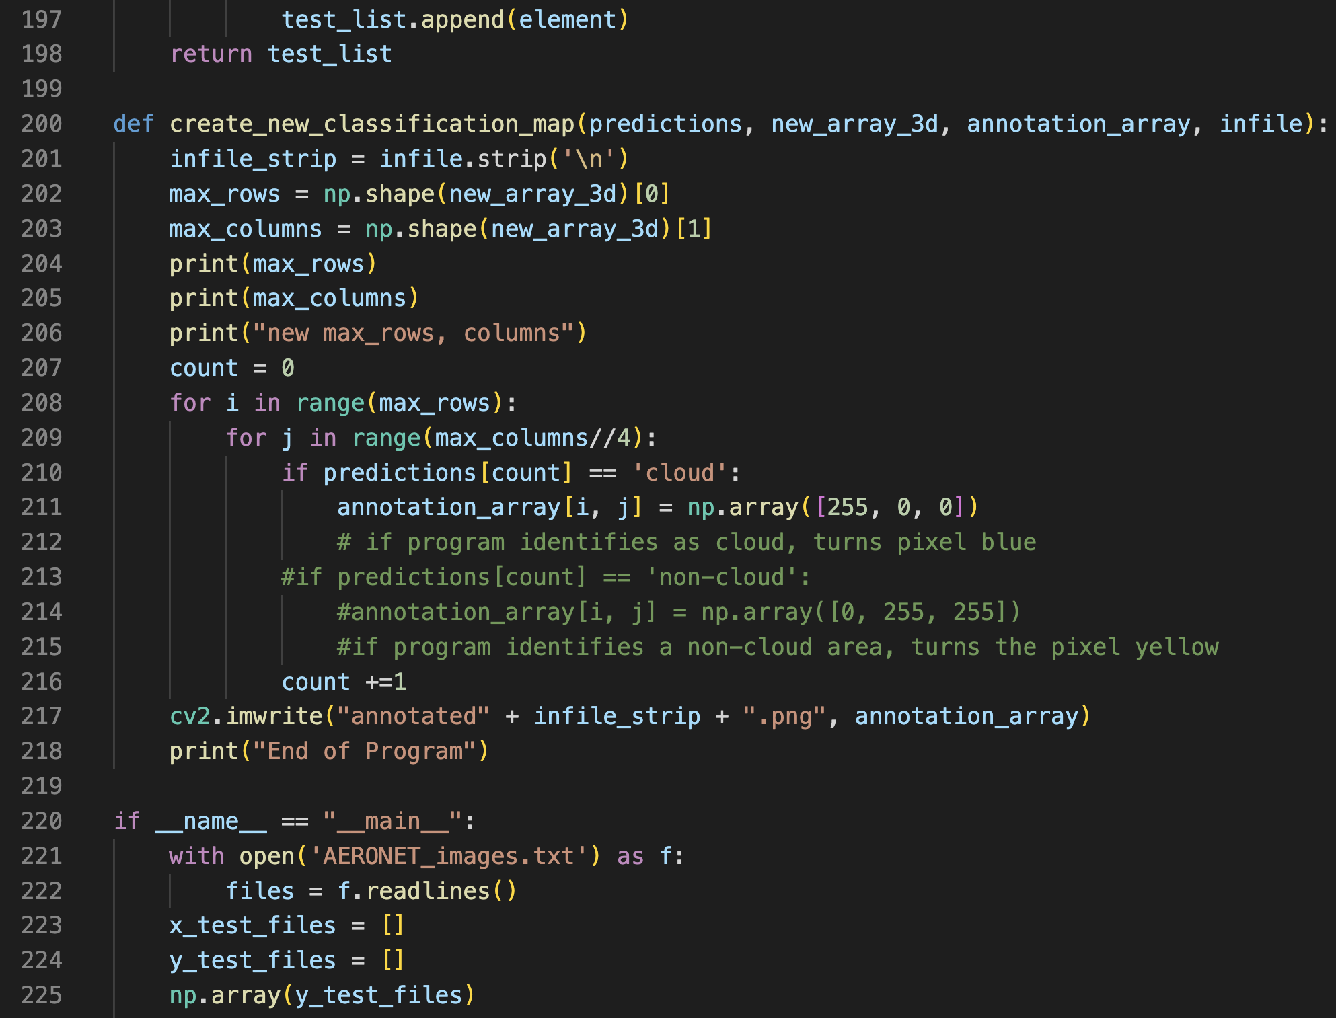
EMIT Mission
Task 2: Code
Notes:
Explain point of knowing aerosol optical depth accuracy

Slide 9
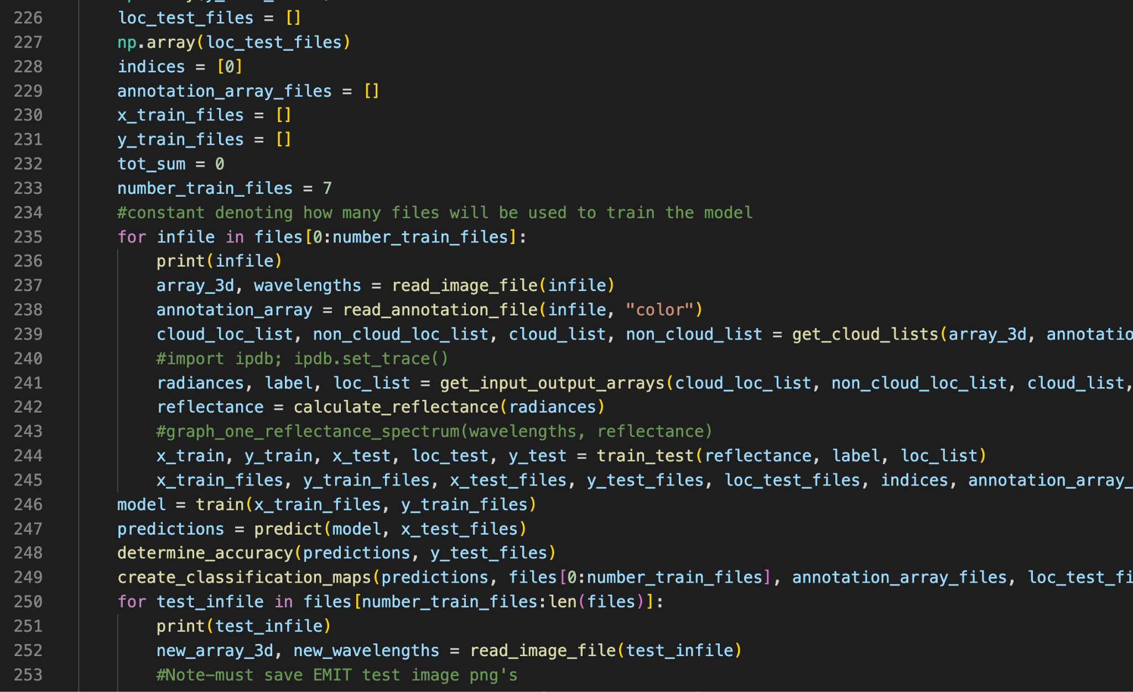
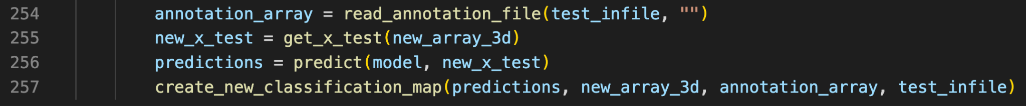
EMIT Mission
Task 2: Code
Notes:
Explain point of knowing aerosol optical depth accuracy

Slide 10
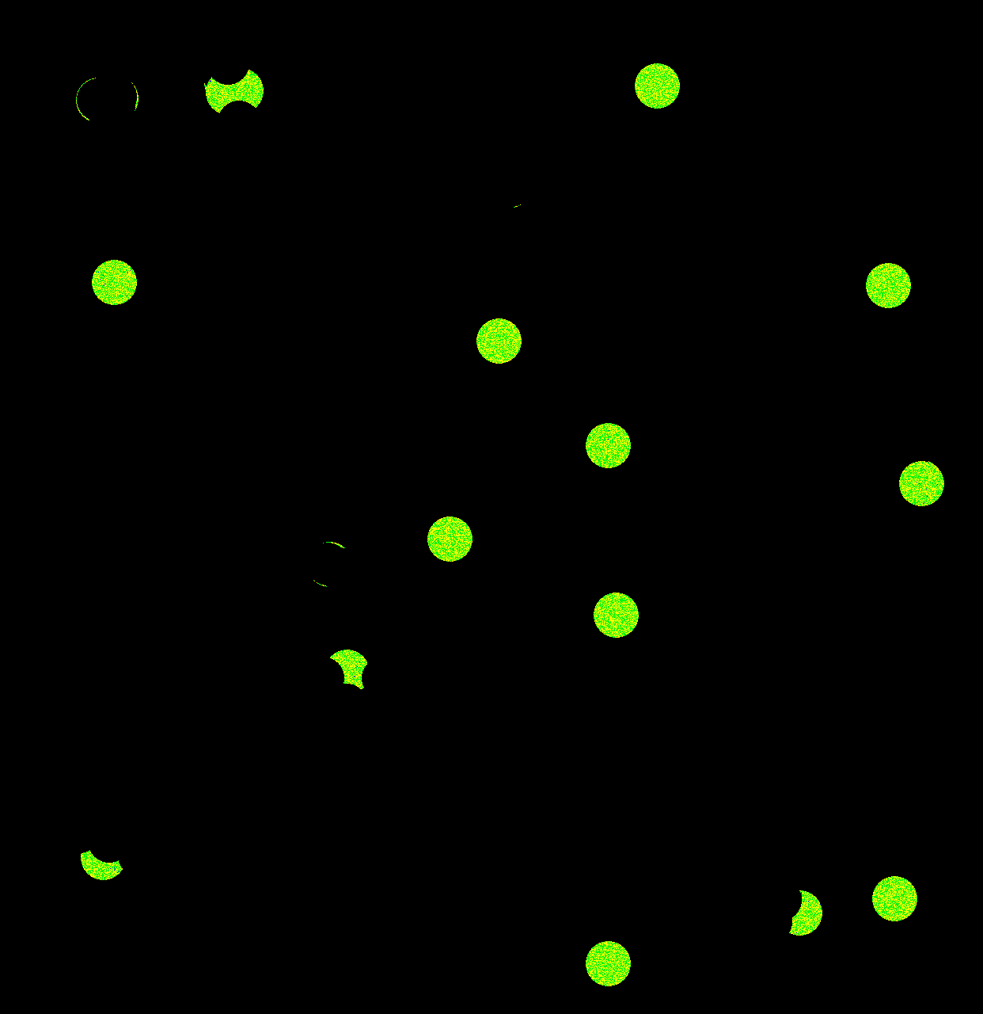

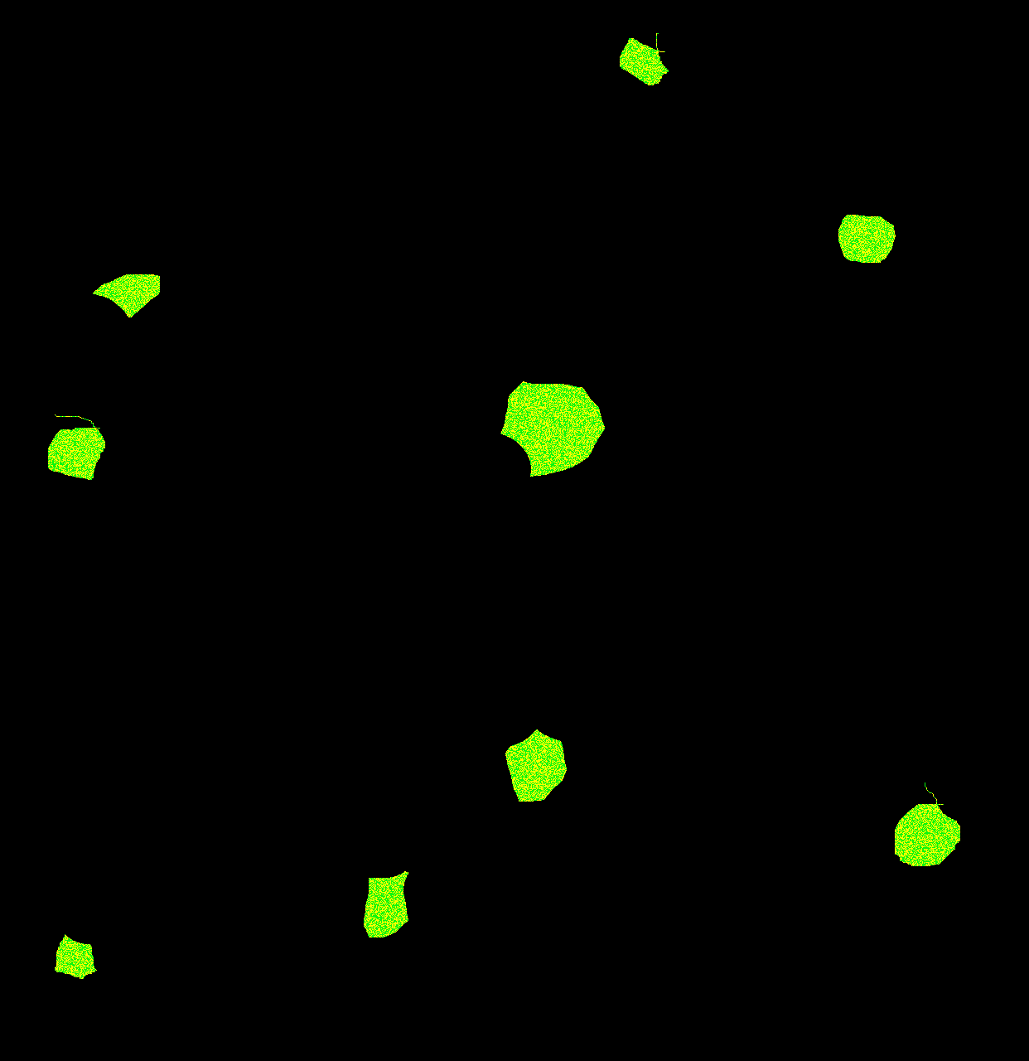
EMIT Mission
Task 2: Results
Notes:
Explain point of knowing aerosol optical depth accuracy

Slide 11
EMIT Mission
Task 2: Results
99.6% Model Accuracy Score!
Notes:
Explain point of knowing aerosol optical depth accuracy

Slide 12
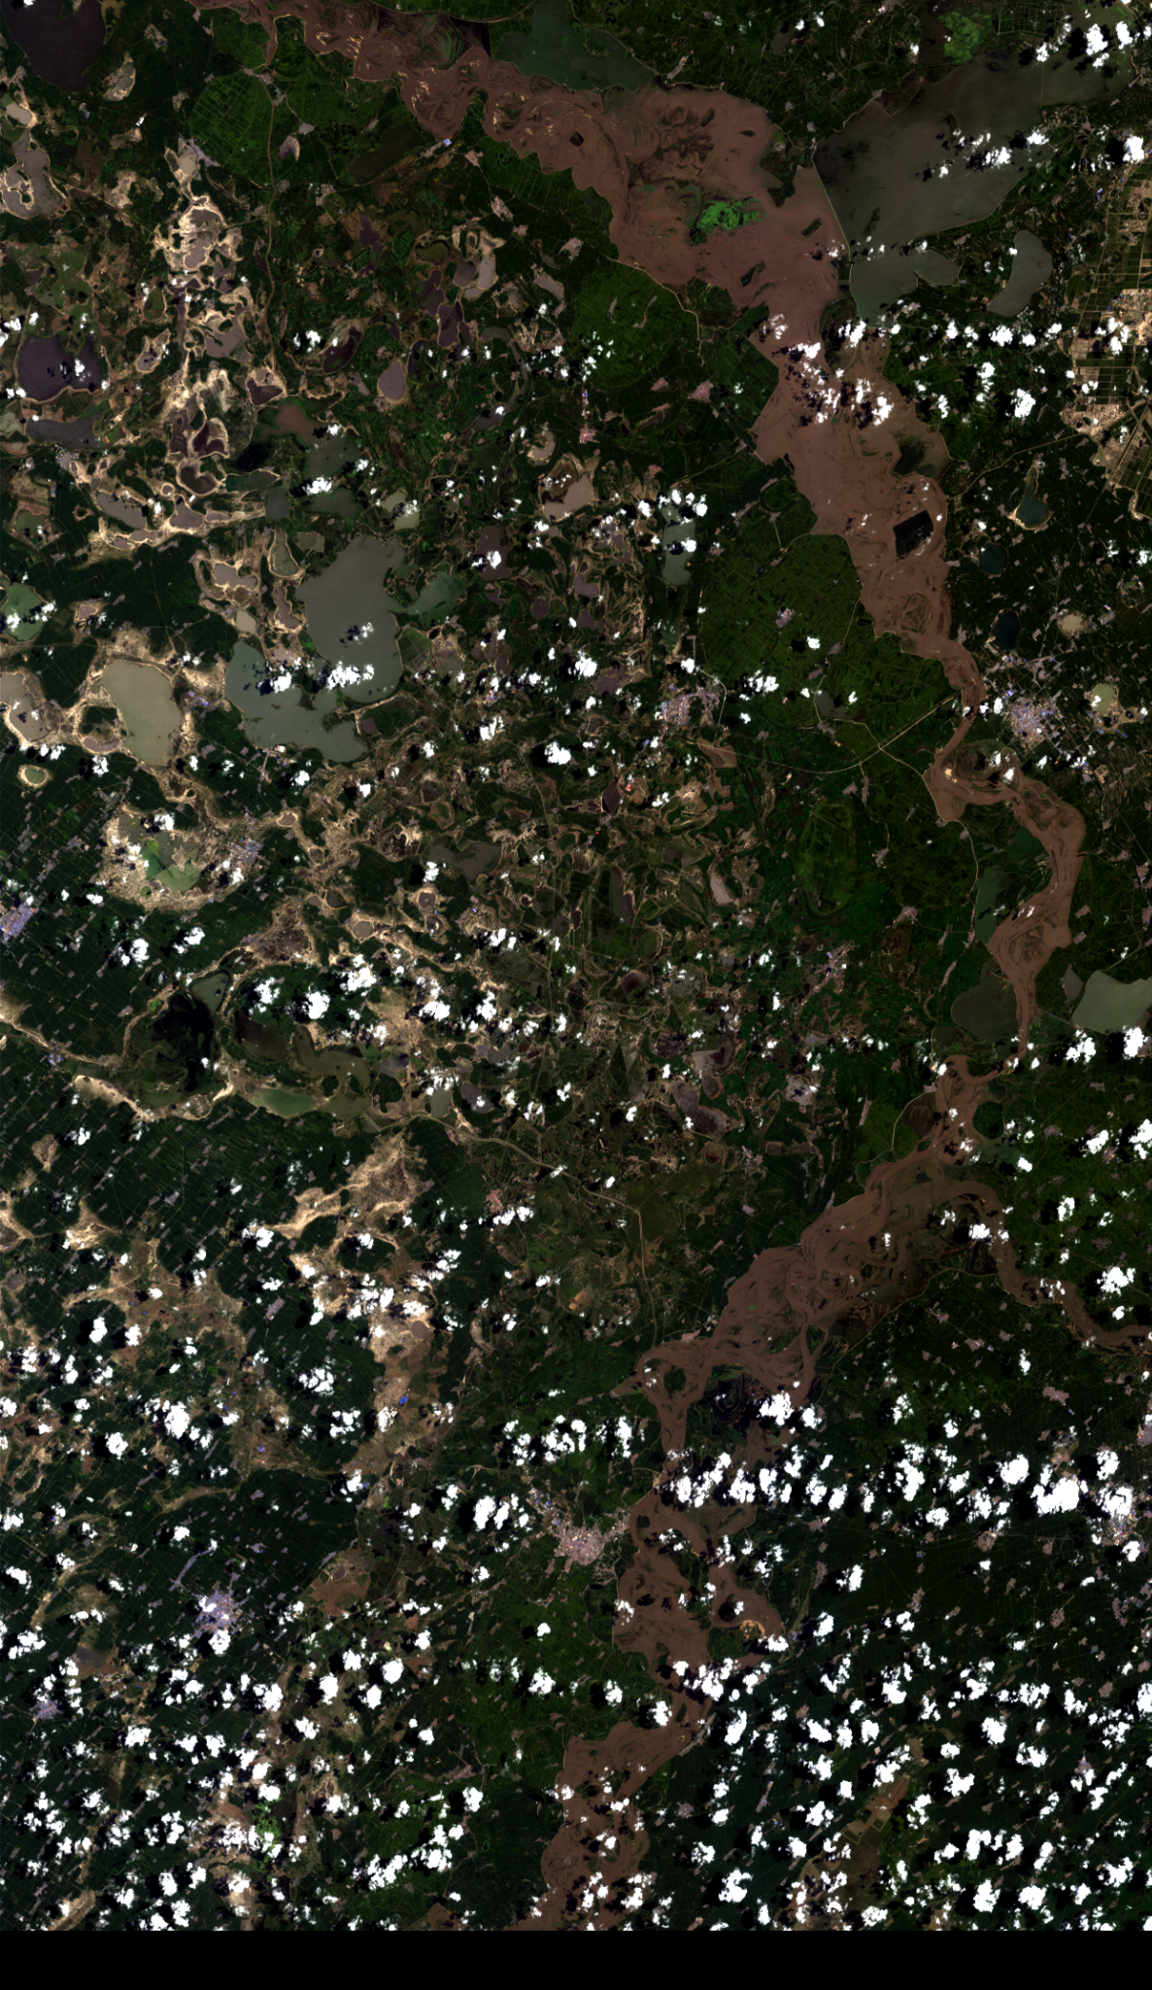
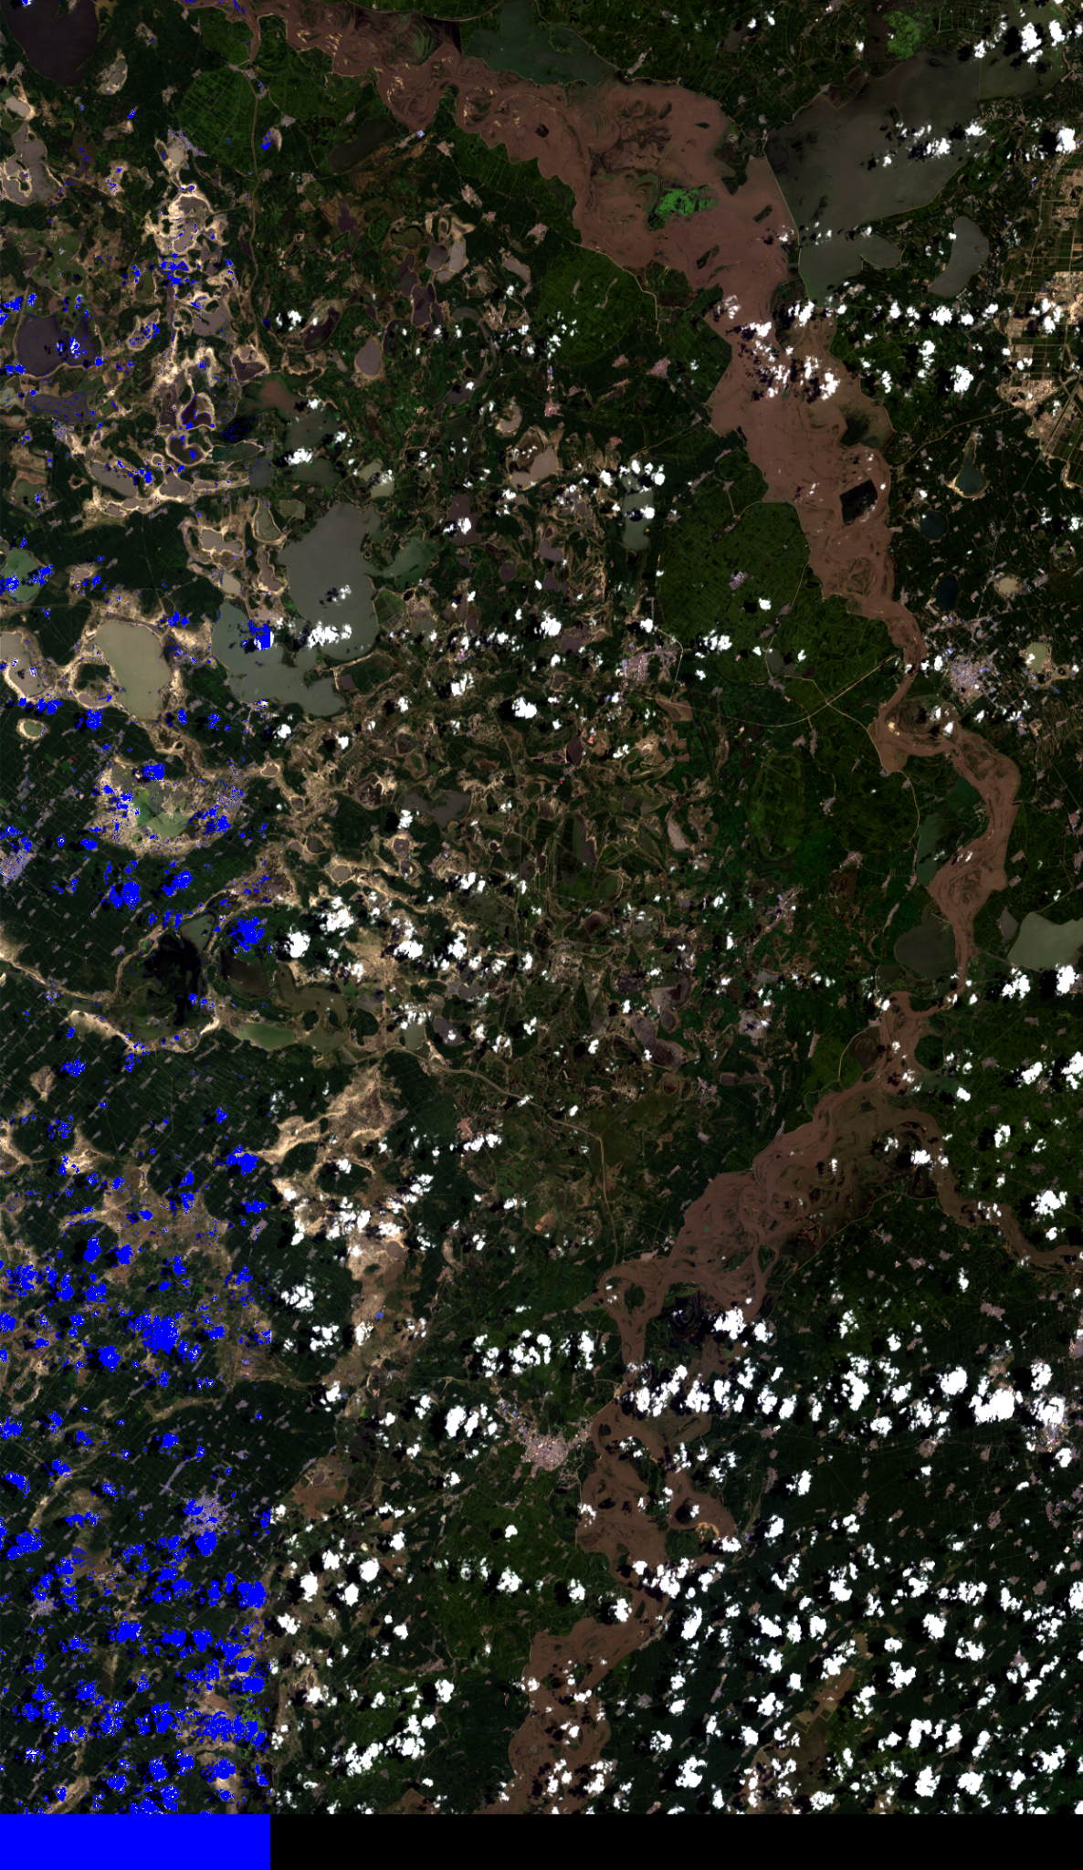
EMIT Mission
Task 2: Results
Only 1/4th of the image is intentionally marked
Notes:
Explain point of knowing aerosol optical depth accuracy

Slide 13
EMIT Images
Future Efforts
Task 1 - Modify program for multiple EMIT images
Task 2 - Increase training set
Task 2 - Train a more diverse set of images
Task 2 - Train more black/dark regions

Slide 14
EMIT Mission
Works Cited
https://www.nasa.gov/feature/goddard/2020/nasa-observes-large-saharan-dust-plume-over-atlantic-ocean
https://earth.jpl.nasa.gov/emit/mission/destination/
https://earth.jpl.nasa.gov/emit/instrument/overview/
https://airbornescience.nasa.gov/sunsat/content/SunSat_AERONET

Slide 15
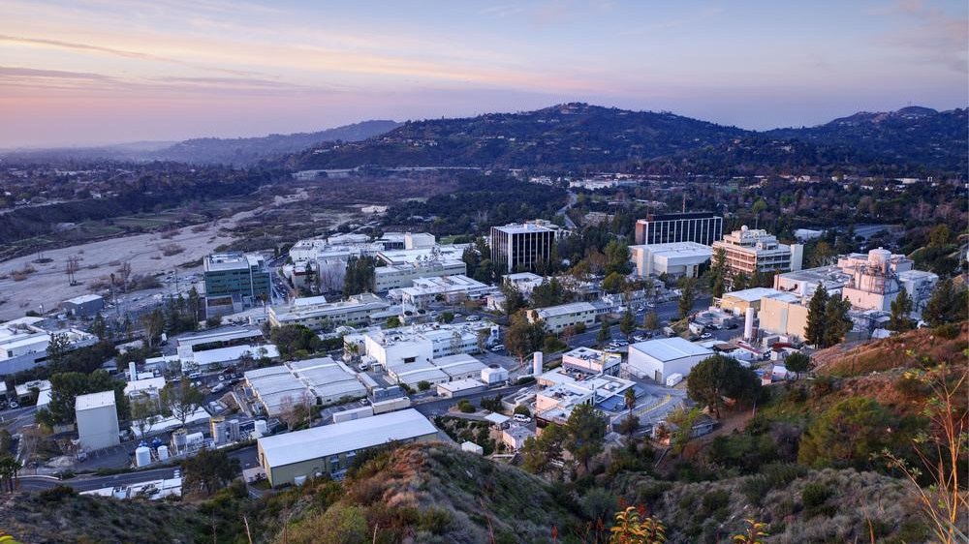


For required markings, please visit https://mh.jpl.nasa.gov

